Slide 1
Despliegue continuo de tu infraestructura cloud con Azure ARM templates
Iván Chesa / Luis Mañez

Slide 2
Notes:
Carlos

Slide 3
Notes:
Carlos

Slide 4

Iván “la barba” Chesa
Dedicated to Azure and SharePoint development in the last years and certified by Microsoft as MCSE: Cloud Platform and Infrastructure.
https://www.linkedin.com/in/iv%C3%A1n-chesa-4284b7133
https://twitter.com/chesaivan

Slide 5


Luis Mañez
SharePoint and Cloud solutions architect en ClearPeople.
Office Development MVP. Cerca de 15 años trabajando con tecnologías Microsoft. SharePoint MCPD y Certified specialist in Developing Azure. OfficeDev PnP Key contributor.
https://twitter.com/luismanez
https://github.com/luismanez
https://medium.com/inherits-cloud
https://www.linkedin.com/in/luismanez/

Slide 6
https://github.com/luismanez/azure-bootcamp-barcelona-2018

Slide 7
Azure ARM benefits

Slide 8
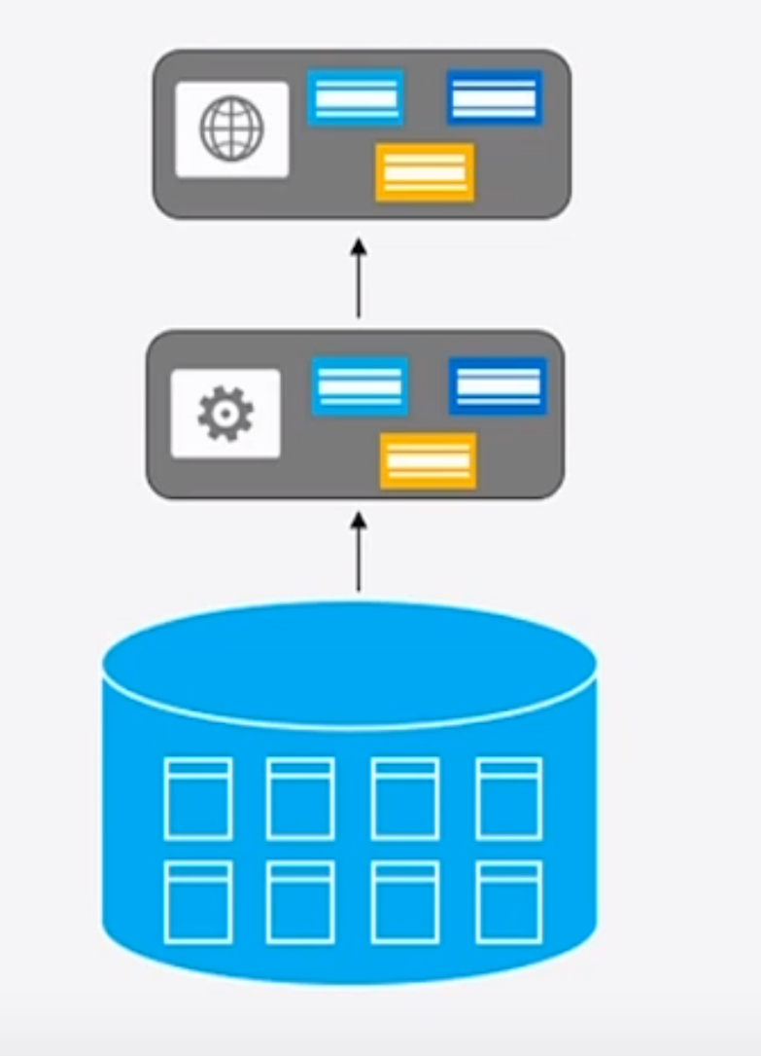
Monolithic Applications

Slide 9
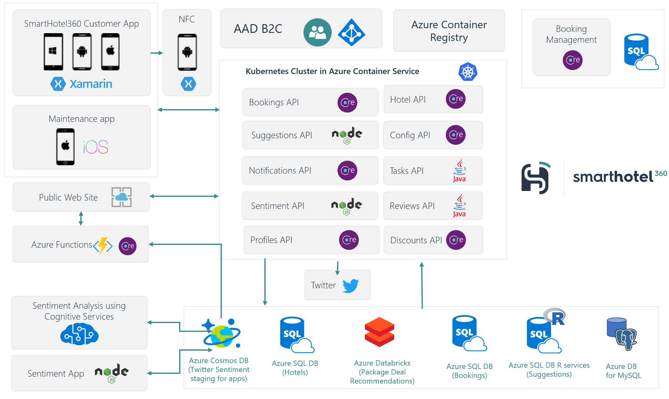
Microservices Applications

Slide 10
… and per environment
DEV
QA
PROD

Slide 11

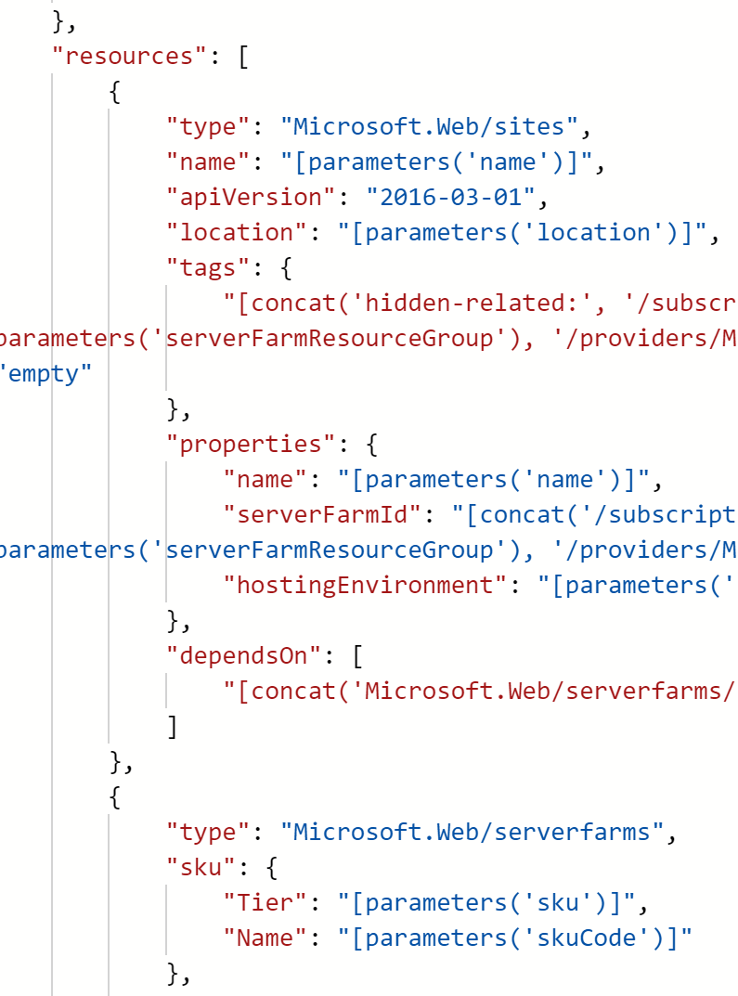
ARM Templates to rescue
PROD
QA
DEV

Slide 12
Azure ARM template anatomy

Slide 13
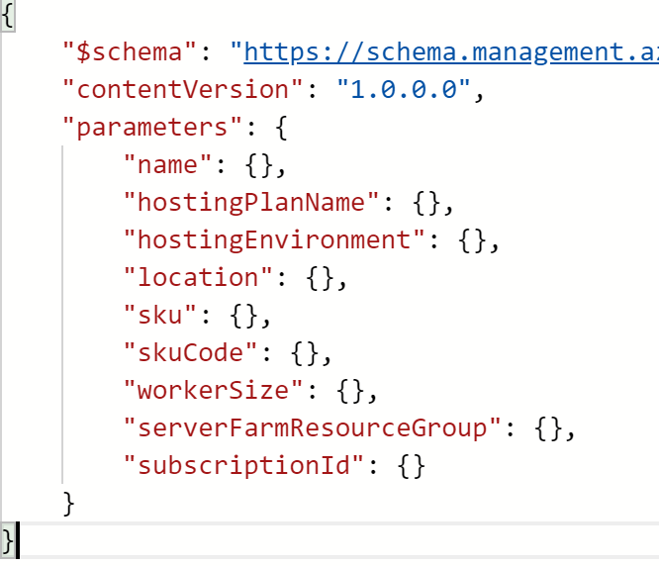
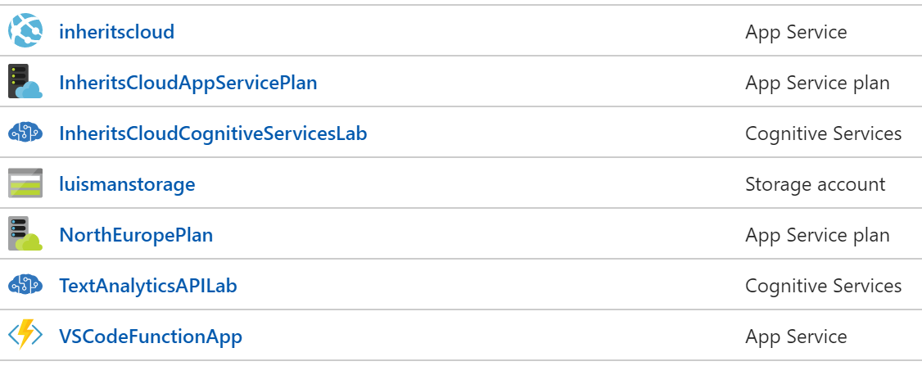
ARM Template Anatomy
Template JSON
Parameters JSON
Power Shell
CLI
API

Slide 14
Azure ARM template demo

Slide 15
Summary
Where to start:
Export from existing Resource Group
GitHub templates
Visual Studio wizard
Parameters
Variables
Functions
References
Loop & Conditionals
Dependencies

Slide 16
Learning Resources
https://azure.microsoft.com/en-gb/resources/templates/
https://docs.microsoft.com/en-us/azure/azure-resource-manager/resource-group-template-functions
https://docs.microsoft.com/en-us/azure/azure-resource-manager/resource-group-template-functions-resource#resourceid
https://docs.microsoft.com/en-us/azure/azure-resource-manager/resource-group-template-functions-resource#reference
https://docs.microsoft.com/en-us/azure/templates/
https://github.com/Azure/azure-resource-manager-schemas/tree/master/schemas

